Slide 1
GIT & GITHUB

Slide 2
Agenda
Git
Centralized Vs Distributed
Difference Between Git and GitHub
Git setup
Workflow of git
Getting a git repository
Git branches
GitHub

Slide 3
GIT
Git was initially designed and developed by Linus Torvalds for Linux kernel development.
Git is a distributed version control and source code management system.
Git is used for project version control in a distributed environment while working on web-based and non web-based applications development.

Slide 4
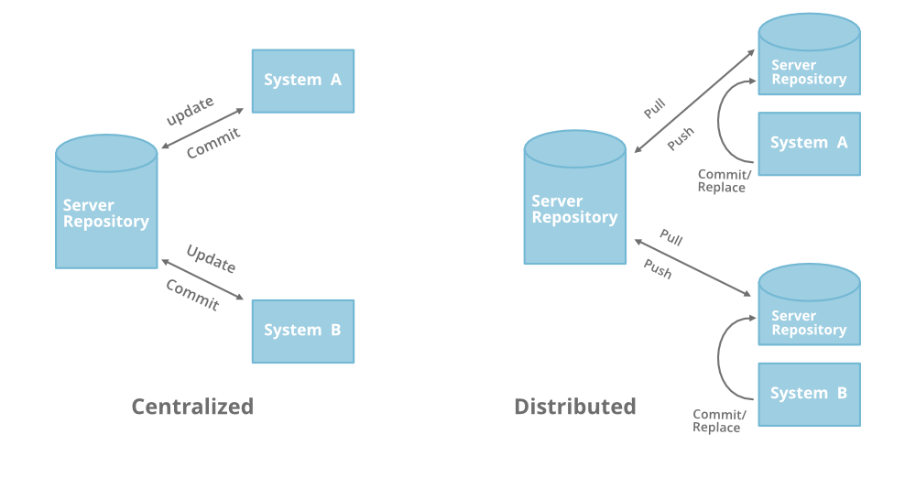
Centralized Vs Distributed

Slide 5
Difference Between Git and GitHub
Git:
Git is a distributed version control system for tracking changes in source code during software development.
Git is installed locally on a system, so developers can manage their source code history using their local machines as repositories. This means there is no centralized server required to use Git, and no needed internet access either.
GitHub:
GitHub is a web-based Git repository hosting service, which offers all of the distributed version control and source code management (SCM) functionality of Git as well as adding its own features.
GitHub lives in the cloud, so Internet access is required. It also has a built-in user-management system and a user-friendly GUI. In addition to its main website GitHub features a desktop version that can be installed on local computers to help synchronize code.
Git can be used without GitHub, but GitHub cannot be used without Git.

Slide 6
Download Git
https://git-scm.com/download/win

Slide 7
Getting Started - First-Time Git Setup
Git comes with a tool called git config that lets you get and set configuration variables that control all aspects of how Git looks and operates.
View all of your settings:
$ git config --list --show-origin
Your Identity
The first thing you should do when you install Git is to set your user name and email address.
This is important because every Git commit uses this information.
$ git config --global user.name "John Doe" $ git config --global user.email johndoe@example.com
Checking Your Settings
If you want to check your configuration settings.
you can use the git config --list command to list all the settings Git can find at that point.

Slide 8
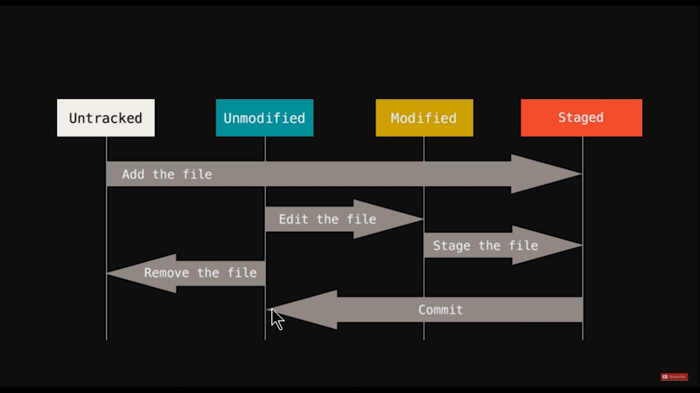

Slide 9
Getting a Git Repository
1. Initializing a Repository: $ git init
2. Check status: $ git status
3. Track files : $ git add --a ($ git add filename)
4. Commit changes: $ git commit -m "message"
5. Checkout(roll back): $ git checkout -f ($ git checkout filename)
6. Log : $ git log ($ git log –p –2)
7. Difference: $ git diff
5. Delete repo: $ rm -rf .git (delete file $ git rm filename)

Slide 10
Git Branch
A branch in Git is a way to keep developing and coding a new feature or modification to the software and still not affecting the main part of the project. We can also say that branches create another line of development in the project. The primary or default branch in Git is the master branch.

Slide 11
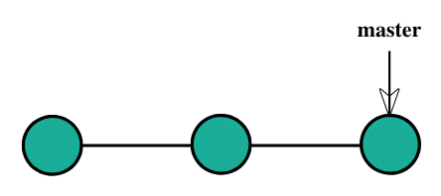
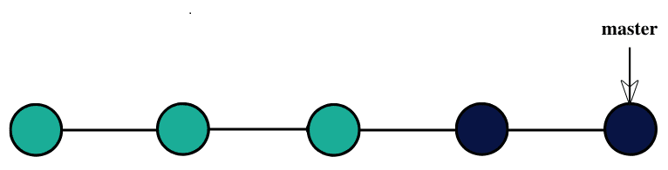
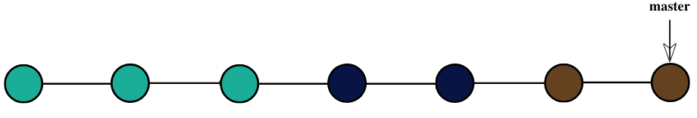
Project Development through linear development

Slide 12
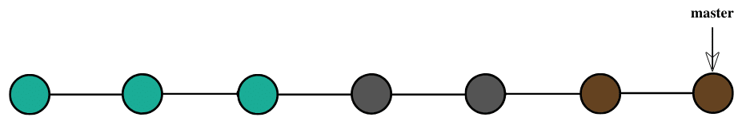
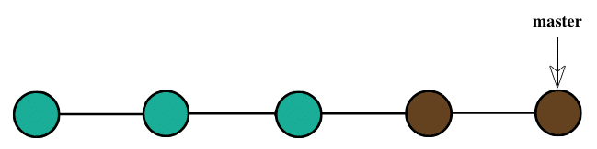

Slide 13
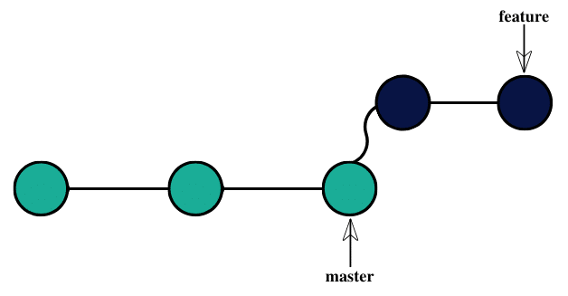
Developing the project through branching.
$ git branch
$ git branch feature
$ git checkout feature
Add & Commit changes in features

Slide 14
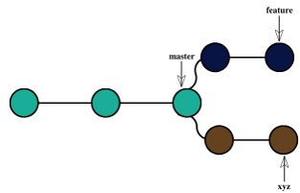
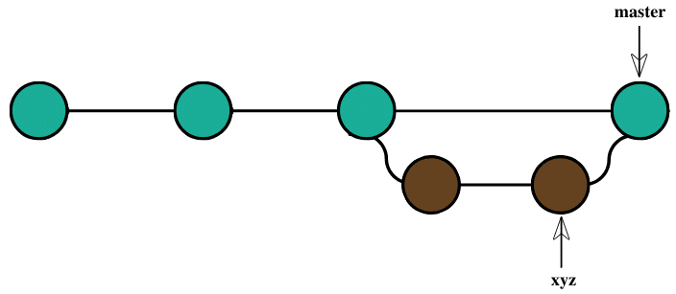
Rollback changes
$ git checkout master
$ git branch -D feature
$ git branch xyz
Add & Commit changes in xyz
Merge changes into master branch
$ git checkout master
$ git merge xyz

Slide 15
GitHub
GitHub has a number of useful features that enable development teams to work together on the same project and easily create new versions of software without disrupting the current versions.
Steps to use GitHub:
1. Sign up for GitHub
2. Install Git
3. Create a Repository
4. Connect remote repository
5. Create a Branch
5. Create and Commit Changes to a Branch
7. Merge Branch
Promoting Your GitHub Profile

Slide 16
$ git branch xyz
$ git checkout xyz
Change file content
$ git status
$ git add –A
$ git commit -m "xyz commit"
$ git checkout master
$ git branch
$ git branch -D feature
$ git branch
$ git push -u origin xyz
$ git merge xyz
$ git push -u origin master
$ git init
$ git status
$ git add –A
$ git status
Change file content
$ git status
$ git add –A
$ git commit –m "message"
$ git status
$ git remote add origin https://github.com/priya-tiwari-sharma/demo.git
$ git branch feature
$ git checkout feature
Change file content
$ git status
$ git add –A
$ git commit -m "feature branch commit"

Slide 17
Thank You

